Slide 1

Exploring climate data’s relevance to predict energy consumption
Conducted in Colaboration with Energinet

Slide 2

Task
Can climate data be used in order to produce precise forecasting for electricity consumption?

Slide 3
Why elecricity consumption and climate data?
Increasingly many sectors are dependent on electricity
Stable electricity grid is important
80% of energy consumption goes to residential heating

Slide 4

The danish electrical grid and weather stations
Two zones, DK1 & DK2
40 weather stations
25 stations for DK1
15 stations for DK2
Notes:
Many stations in CPH, but that is also where a majority of the consumptions is

Slide 5
3 types of data
Data for electricity consumption
Weather data for observed values - Will be used to train the model
Weather data from forecasts - Will be used as test set

Slide 6
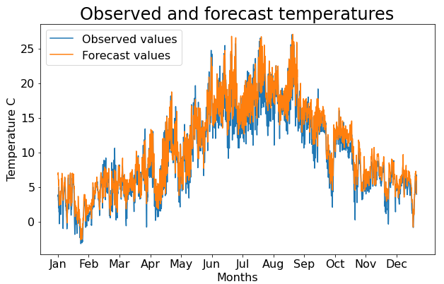
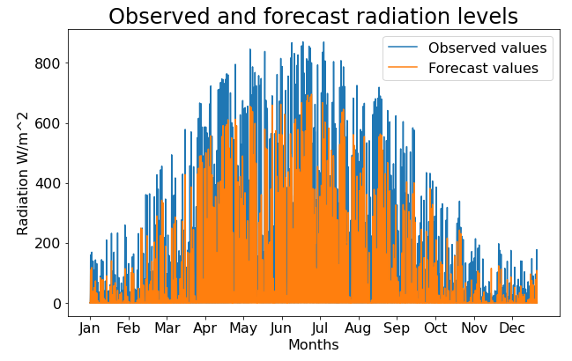
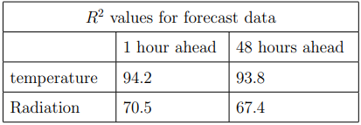
Accuracy of DMI’s forecasts?
Temperature surprisingly accurate
Radiation not so much
Easier to predict temperature
Notes:
No real change going from 1hr to 48hr

Slide 7

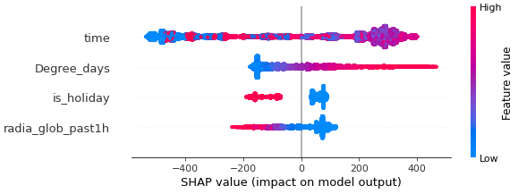
Data exploration
Searching for correlations in the aquired data
Degree days
SHAP-values
Time is difficult to decipher

Slide 8

Two models
Literature review
XGBoost - Extreme Gradient Boosting
LSTM-NN - Long-Short-Term Memory Neural Network

Slide 9
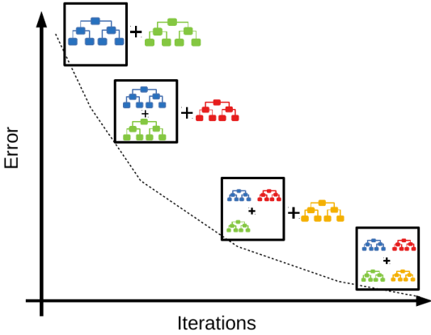
XGBoost
Ensemble of weak learners
Decision trees
Gradient boosting
eXtreme regularization
Percieved as being very accurate
Notes:
The x is capital because that is where the x in xgboost comes from
L2 reg introduces bias to the prediction in order to reduce variance
L1 reg

Slide 10
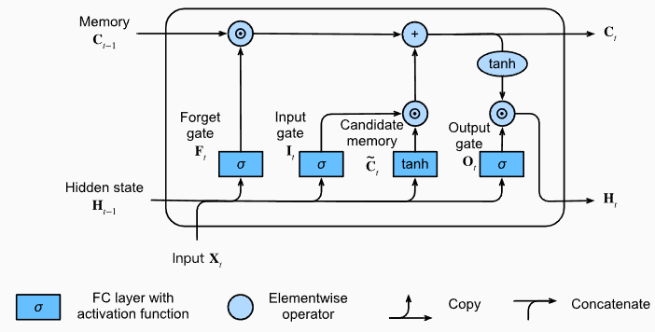
LSTM-NN
Subcategory of a recurrent neural network
Subcategory of a neural network
Can store information between iterations
Sequential/Temporal data
Hidden state + memory cell
Notes:
Has both hidden state and memory cell
\odot means elementwise product or the dot product

Slide 11
Implementation
Train data from 2010-17
Validation set from 2018-19
Change in behaviour from COVID and energy prices
Two error metrics: - Mean Squared Error (MSE) -R^2 (R squared)
A naive model

Slide 12
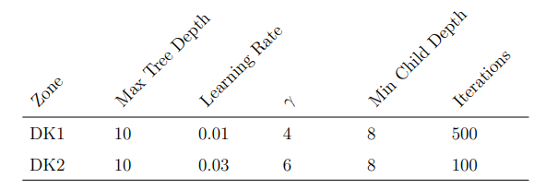
Optimal XGBoost
Found by brute-forcing
Proving the speed of the XGBoost
341 models trained in 40 minutes

Slide 13
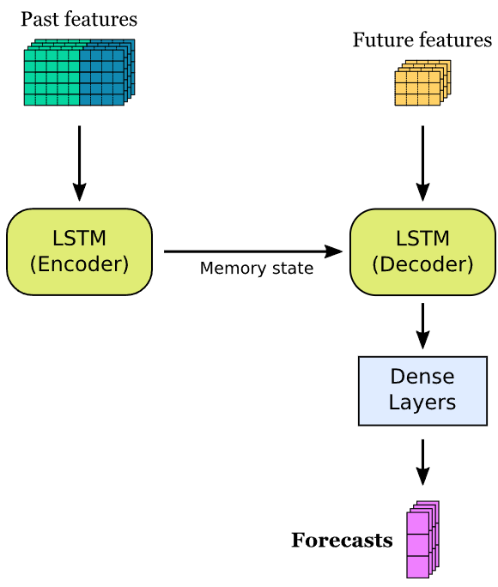
Encoder/Decoder LSTM
The previous used data is not necesarily the past input
For training everything is observed values
Different for actual forecasts

Slide 14
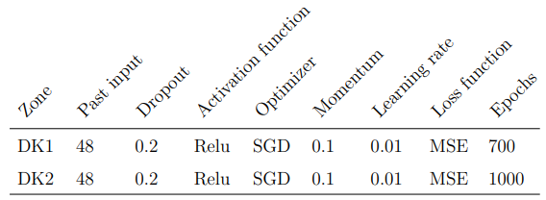
Optimal LSTM-NN
Same setup
Different epochs
Adam optimizer overfitted

Slide 15
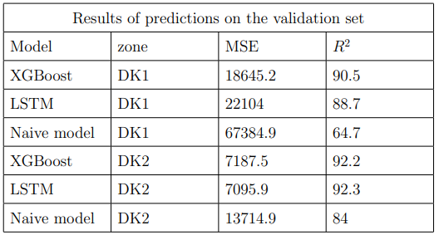
Validation results
Overall satisfying performance
XGBoost best for DK1
LSTM-NN barely outperforms XGBoost for DK2
Both outperforms the naive model

Slide 16

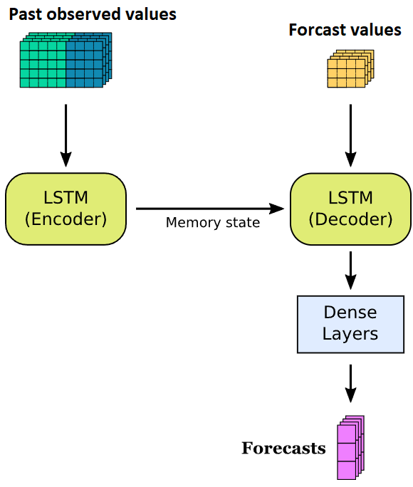
Now for something very interesting
New results
After the project was turned in a problem in the code was found
No observed values in the forecasts

Slide 17
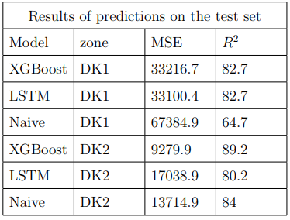
Why did it happen?
Test results in the report
The results appeared to be true
I did not illustrate the results enough
Rookie mistake
Rushed

Slide 18
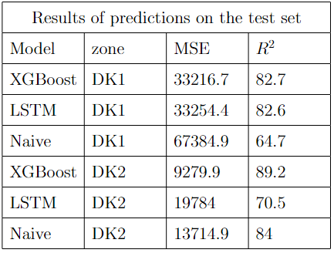
New results
New test results
Not better
Atleast they are correct
LSTM for DK2 is overfitting - It was run with lower epochs and the accuracy went up

Slide 19
Conclusion
Climate data can be used to predict elecricity consumption
In terms of this project, LSTM is not worth it
XGBoost performs well, for less recources

Slide 20
Biggest take-aways from this project
Using other features to try and capture summer months
The naive model is tough competition for DK2
Illustrate your predictions in different manners
Dont just trust you error metrics
Notes:
Læg mere kræft på mine valg
Valg af data
Time til time
Overfitting
Agenda/emner
Største take-away
Hvis jeg startede forfra, havd ville jeg så?

